Slide 1
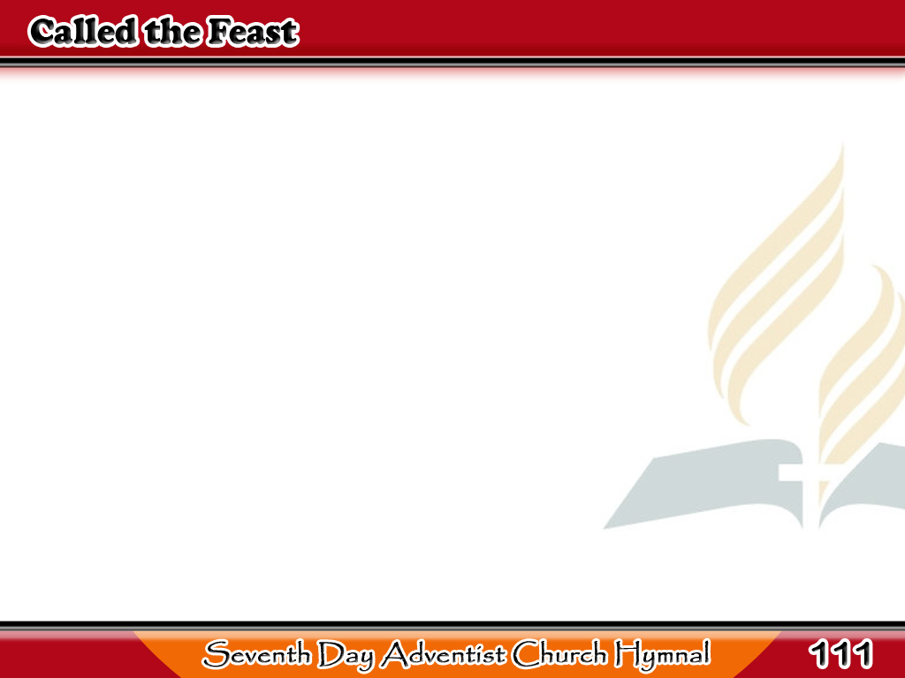
Sa Kasalanan Aanyayahan
Called to the feast
by the King are we,
Sitting, perhaps,
where His people be;
1/4

Slide 2
Sa Kasalanan Aanyayahan
How will it fare, friend,
with thee and me
When the King comes in?
1/4

Slide 3
Sa Kasalanan Aanyayahan
-Refrain-
When the King comes in, brother,
When the King comes in!
How will it fare with thee and me
When the King comes in?
1/4

Slide 4
Sa Kasalanan Aanyayahan
Crowns on the head
where the thorns have been,
Glorified He who once
died for men;
2/4

Slide 5
Sa Kasalanan Aanyayahan
Splendid the vision
before us then,
When the King comes in.
2/4

Slide 6
Sa Kasalanan Aanyayahan
-Refrain-
When the King comes in, brother,
When the King comes in!
How will it fare with thee and me
When the King comes in?
2/4

Slide 7
Sa Kasalanan Aanyayahan
Like lightning’s flash
will that instant show
Things hidden long
from both friend and foe;
3/4

Slide 8
Sa Kasalanan Aanyayahan
Just what we are
will each neighbor know,
When the King comes in.
3/4

Slide 9
Sa Kasalanan Aanyayahan
-Refrain-
When the King comes in, brother,
When the King comes in!
How will it fare with thee and me
When the King comes in?
3/4

Slide 10
Sa Kasalanan Aanyayahan
Joyful His eye
shall on each one rest
Who is in white wedding
garments dressed;
4/4

Slide 11
Sa Kasalanan Aanyayahan
Ah! Well for us
if we stand the rest,
When the King comes in.
4/4

Slide 12
Sa Kasalanan Aanyayahan
-Refrain-
When the King comes in, brother,
When the King comes in!
How will it fare with thee and me
When the King comes in?
4/4

